Slide 1
Netflix Movies and TV SHOWS Clustering
SINDHUJA J

Slide 2
Objective
Focus on clustering Netflix movies and TV shows based on various features like genre, rating, and duration etc..
Help users discover content based on preferences.
Domain
Unsupervised Machine Learning.
NLP - Text preprocessing.

Slide 3
Steps Involved
Importing libraries and exploring the basic data info
Data Visualization
Data preprocessing
Text preprocessing
Text Vectorization with TF-IDF
Feature encoding & feature scaling
Model Building & Evaluation

Slide 4
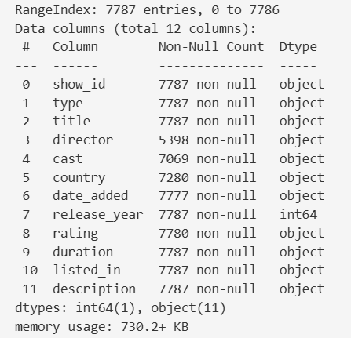
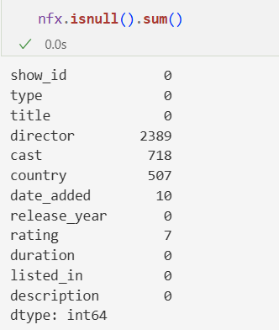
About the Data ….
Total Rows and Columns - 7787/12
Release_year Rest of the columns
Numeric
Object
Director
Cast
Country
Date_added
rating
Null values

Slide 5
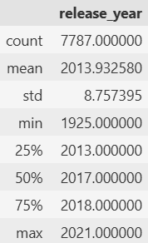
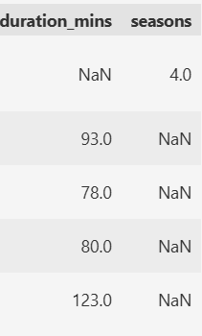
Cont…
Statistical information of release_year feature shows below info:
Mean < median - Slight left skewed distribution which requires feature scaling.
Most of the data distribution is centered around recent years - 2013 to 2017. However, there are
few classic old entries as the minimum year is 1925.
Chances of outliers.
Handling Duration
It contains mixed data showing number of seasons for the TV show and number of
minutes for the movie. We can distinguish both with the help of type column.
Removed Duration column after the above step.

Slide 6
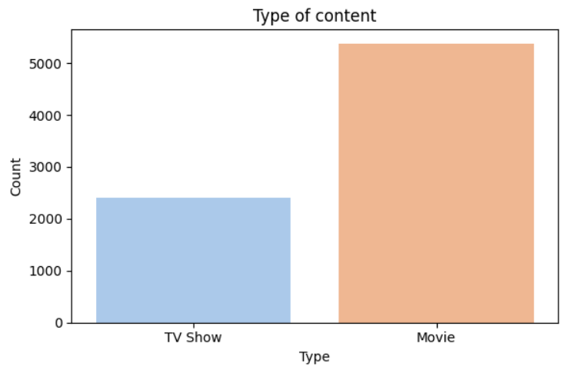
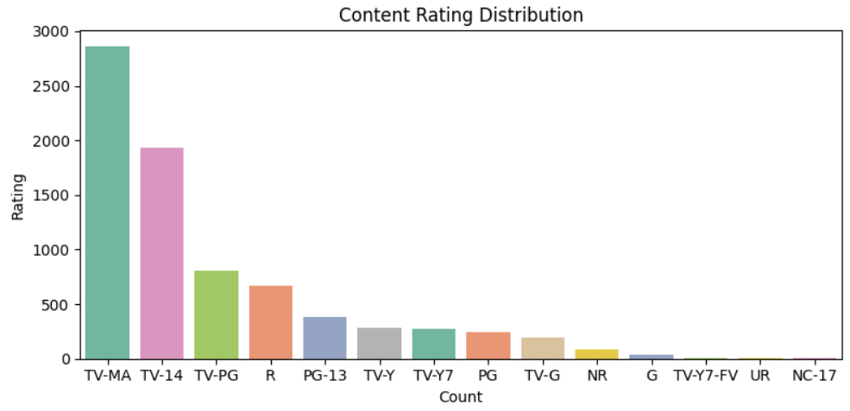
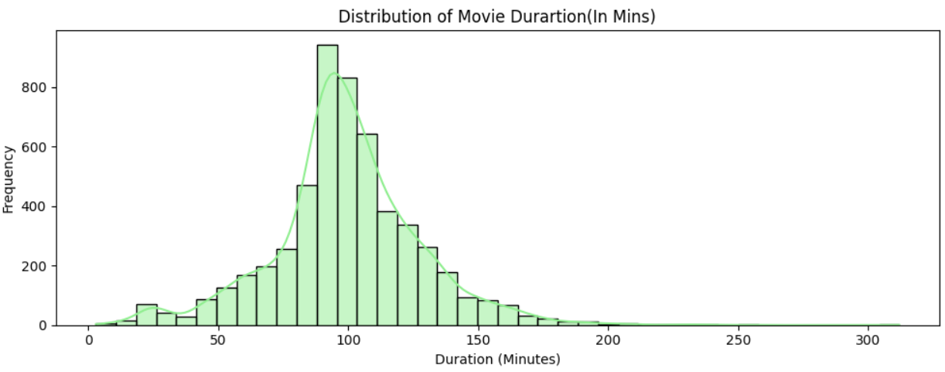
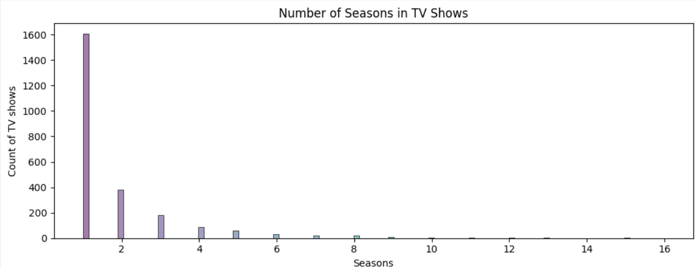
Data Visualization
Univariate Analysis
Content type & rating - count plot
Content released over years - bar plot
Length of the content description & Movie Duration (in mins) & No of seasons in
TV shows – histplot

Slide 7
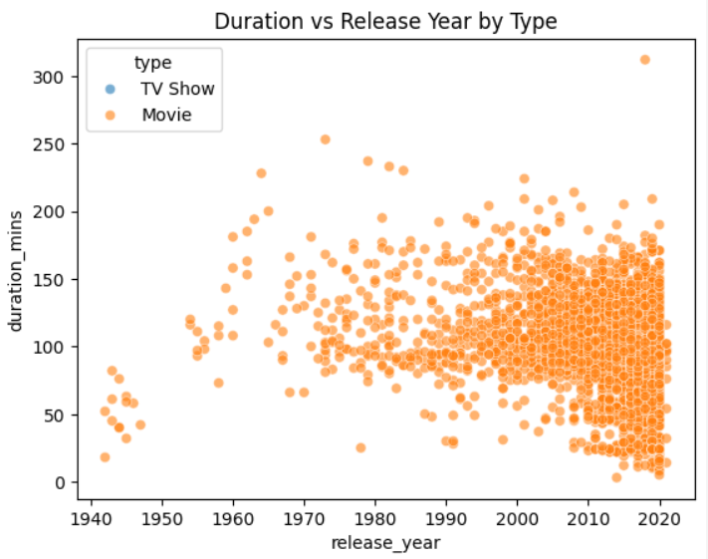
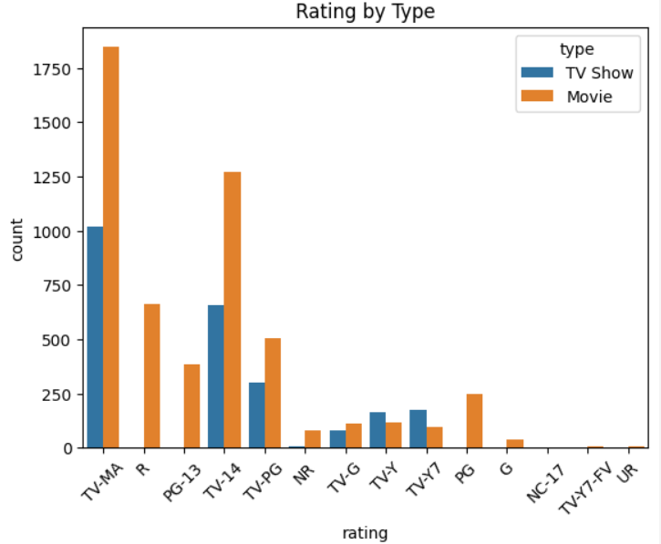
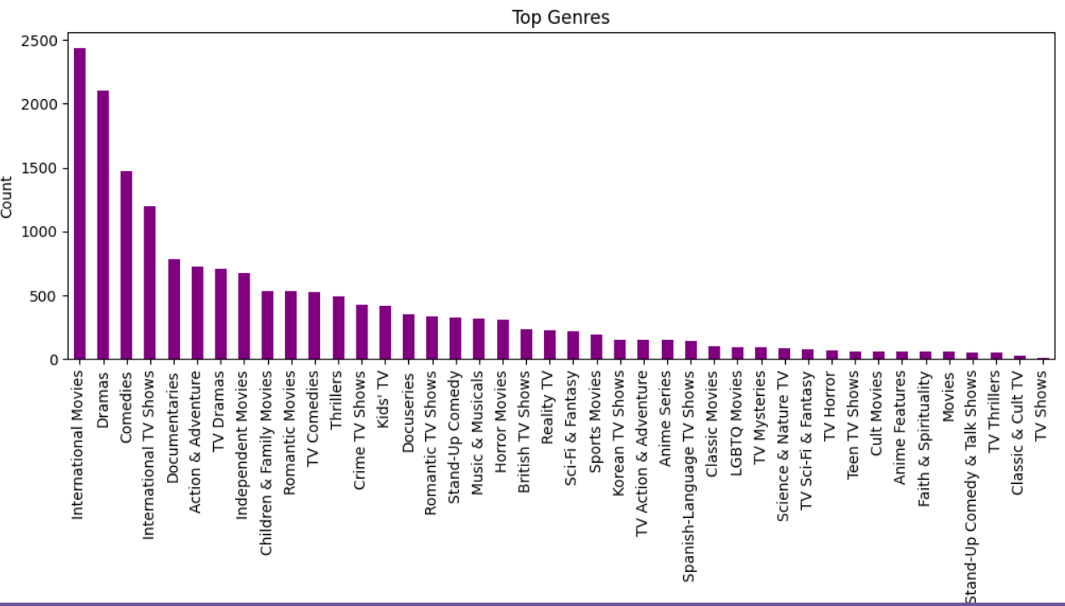
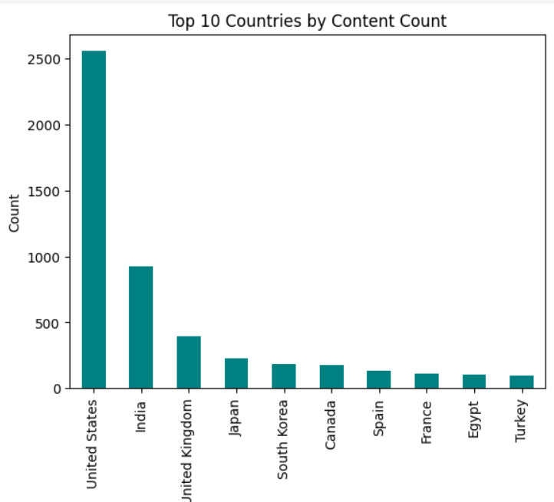
Data Visualization
Bi variate Analysis
Duration (In Mins/seasons) vs. release year - scatter plot
Rating vs. Content type - count plot
Top 10 countries by content - bar plot
Genre analysis - bar plot
For all numeric features - heatmap

Slide 8
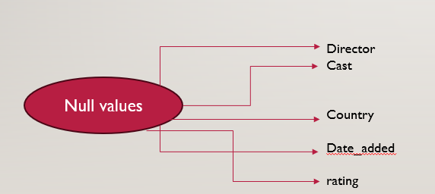
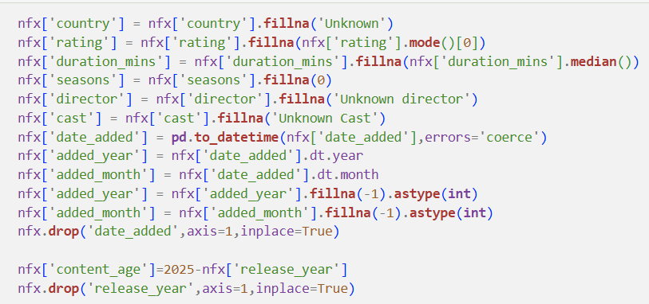
Data Preprocessing - Null handling

Slide 9
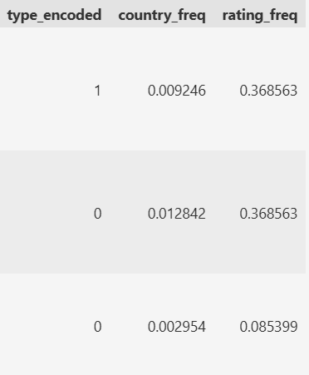
Data Preprocessing - Feature Encoding
Label encoding - content type
Binary/ordinal category variable.
Frequency encoding - country and rating
Replaces each category with how frequently it appears in data.
No label/target column available, hence it suits here.
Reduces dimensionality
Helps higher cardinality

Slide 10
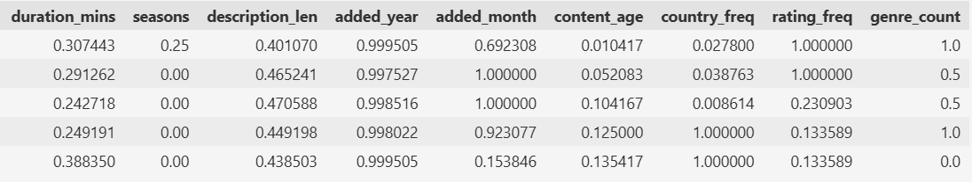
Data Preprocessing - Feature Scaling
Min-Max Scaler
Scales the features between 0 and 1 - useful when we want to preserve the shape of the original distribution and ensure all features contribute equally to distance-based models like KMeans or DBSCAN.

Slide 11
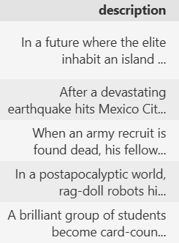
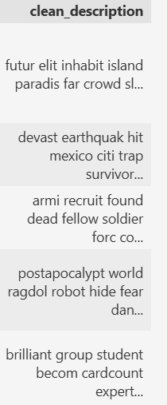
Text preprocessing
Remove punctuation
Remove numbers
Tokenize
Stemming

Slide 12
Model Building and Evaluation
KMeans Clustering
Elbow Method shows a noticeable "elbow" at k=3 or 4, indicating diminishing returns in SSE reduction after that.
Silhouette Score is highest at k=2, but the gap isn't drastic up to k=4.
Choosing k=3 in the PCA cluster visualization is a reasonable and balanced choice.
Davies-Bouldin Index of 1.26 indicates tight and well-separated clusters.
PCA plot shows clear separation among clusters, compact and distinct groups → supports validity of k=3 selection.

Slide 13
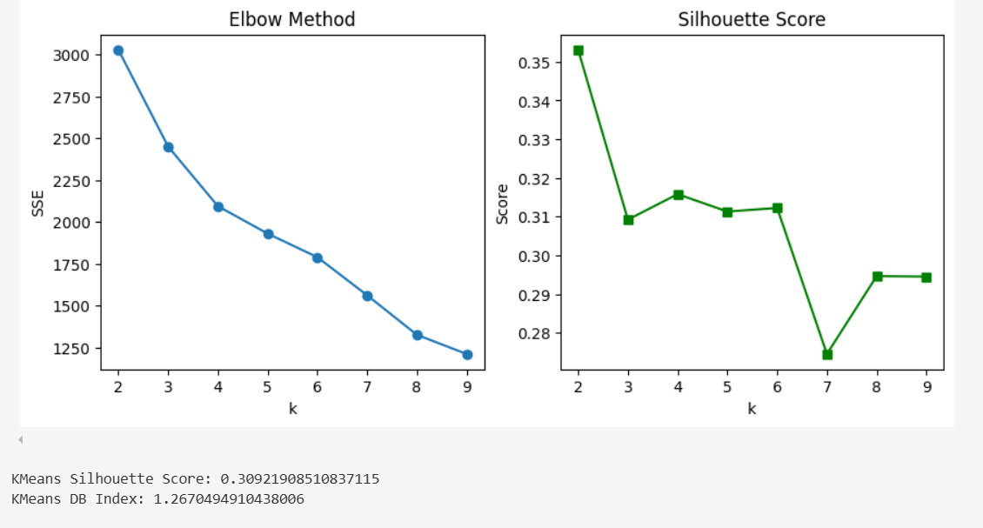
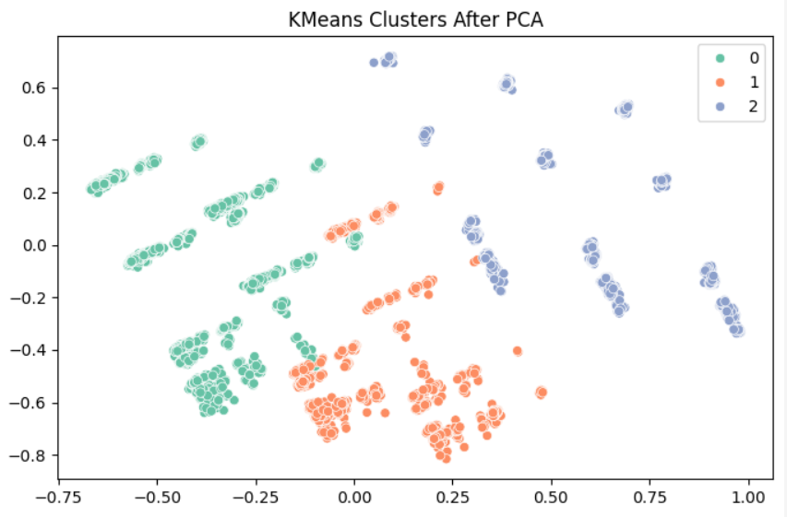
Output of KMeans Clustering

Slide 14
Model Building and Evaluation
Hierarchical Clustering
Lower silhouette and higher DB index suggest overlapping or elongated clusters.
Dendrogram shows a few dominant clusters but lacks clean separation compared to KMeans.

Slide 15
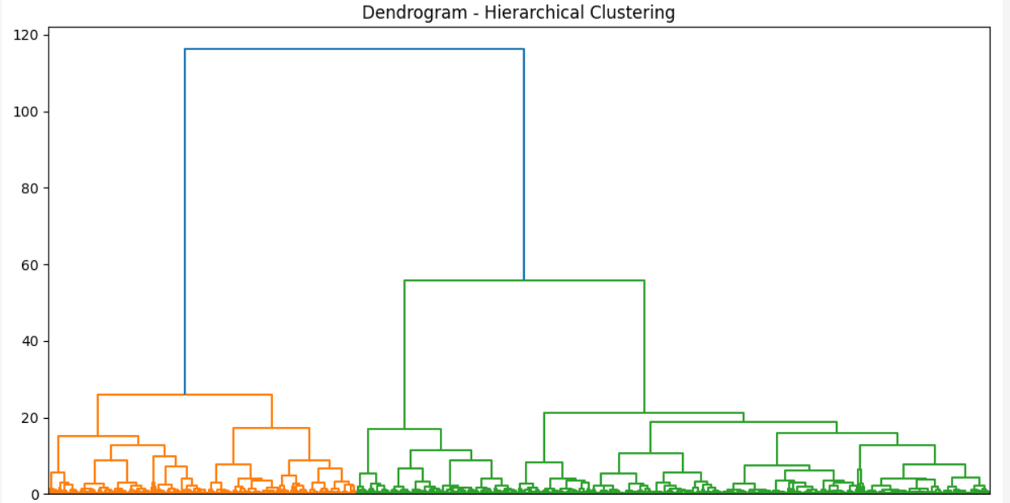
Output of Hiearchical Clustering

Slide 16
Model Building and Evaluation
DBSCAN Clustering
Performs close to KMeans in metrics but slightly worse.
DBSCAN is density-based, useful if clusters are non-spherical—but your data seems well-separated by KMeans, so DBSCAN may not add much value here.

Slide 17
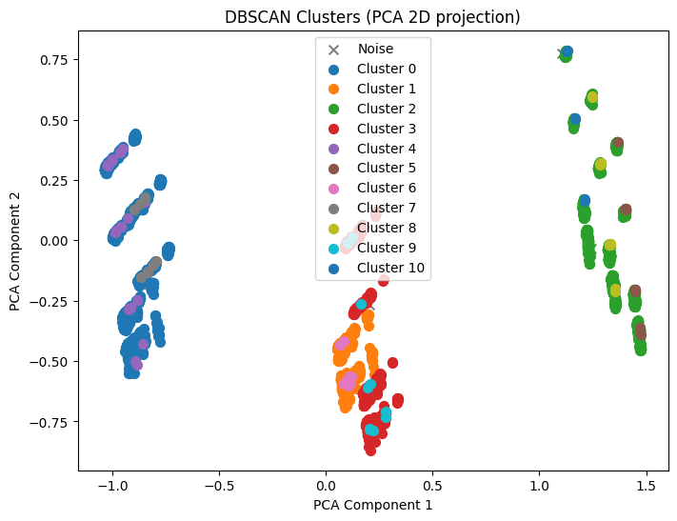

Model Building and Evaluation

Slide 18
Model Building and Evaluation
Conclusion:
Use KMeans (k=3)
KMeans outperforms both DBSCAN and Hierarchical in clustering quality based on both evaluation metrics and PCA visualization.

Slide 19
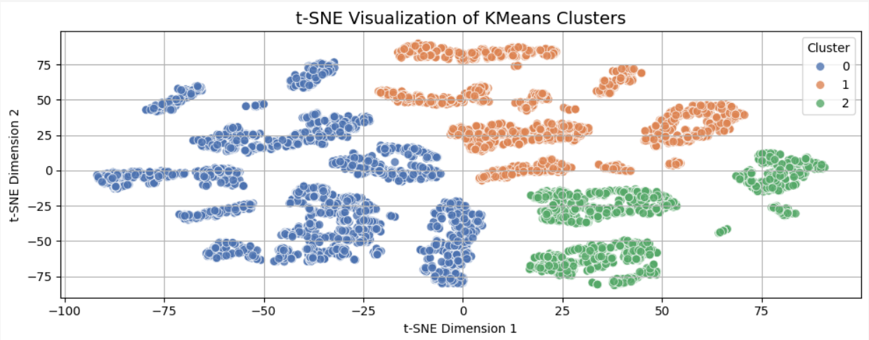
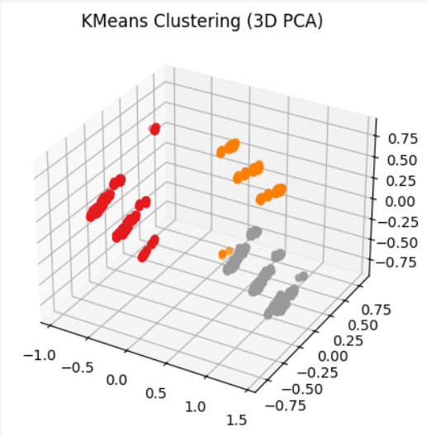
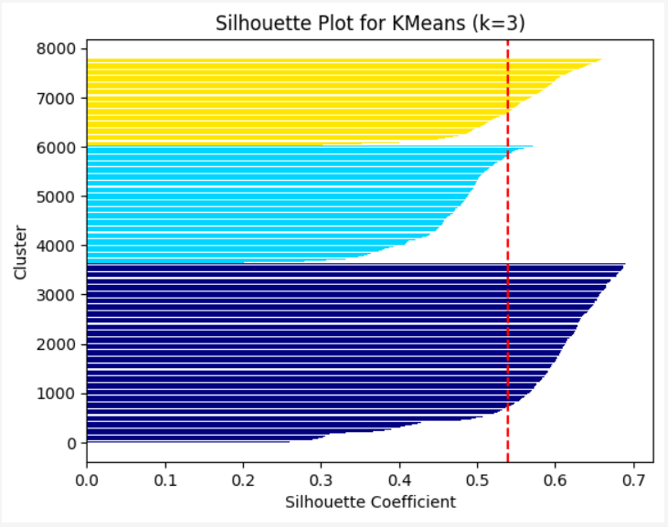
Validating the Best Model

Slide 20
Thank You ☺
SINDHUJA J

